Slide 1
An Untitled Mining Game
Notes:
Capstone project
Hello everyone, I’m Ezra Skwarka and I'm going to be talking about My Capstone project, An Untitled Mining Game. Specifically, I'm going to discuss what an Untitled mining game is how I made it (both tools and processes), how I tested it, and what I learned from makeing it. At the end I have a short demo to show off as well

Slide 2

Overview
What is “An Untitled Mining Game”?
Notes:
1st an overview, that is to say what is an Untitled mining game

Slide 3
Overview
Inspired by Idle Games (AdVenture Capitalist, Cookie Clicker, etc.)
Encourage Active Engagement, Idle is a Bad Word®
Incremental Game, Big numbers go WOOSH
Designed around core “Mine, Refine, Upgrade”
Notes:
An Untitled mining game is well a mining game inspired by various idle games that I grew up with such as Adventure capitalist, Cookie Clicker, and things of that nature. In these games you cultivate resources and improve your way to gather resources so that they feed into each other when you get a sort of exponential Snowball Effect.
I personally quite enjoy these games because I like seeing big numbers and I like seeing them go up fast. However one sort of flaw I encounter when I'm personally playing these games is that, at a certain point, they almost become a fully autonomous game. You just show up, click around for about 5 minutes, and wait for the next day.
Most of these games exist on mobile devices so that design choice makes some amount of sense, but I don't personally Vibe with it I don't like it. I wanted to create a game that uses these principles of exponential growth but encourages more active engagement from the player.
I feel that this is reflected in my design thesis "mine, refine, upgrade" which I used when designing and creating all systems and components of this game, at some level every decision I made fed back into this core tenant

Slide 4
Technologies used
What did I use to create “An Untitled Mining Game”?
Notes:
With that background that I'd like to talk about the Technologies I used. In other words what did I use to create an Untitled mining game

Slide 5

Technologies Used
Game Maker Studio 2, GML
Why GMS over tools like Unity?
Worthwhile Experience?
Asset Creation and Credits
Notes:
Well first and foremost I chose to use gamemaker Studio 2 and its complementary language gamemaker language. I chose gml and GMS over other more popular tools like Unity because Unity was a bit more than what I needed for this project. You don't need a sledgehammer to put a nail in the wall and oftentimes if you do that you're going to damage the wall.
I did have some troubles learning game maker studio and gml because they're based off of the C sharp programming language which I've had no experience with, but all in all I do very much consider it to be a worthwhile experience because of everything I learned both from a technical and design and workflow perspective
Also real quick, some of the assets I used specifically the tiles I used to create the game map I did have from an asset pack I had purchased in the past before I started on this project. because of the conditions under which I purchased it I'm still fully allowed to use them as temp assest for personal projects but I did want to state that they weren't my own creation. Although all other visual assets of the game I did create myself

Slide 6
Development Process
Yeah, but like, how did I create “An Untitled Mining Game”?
Notes:
So that's cool, you see how I created an Untitled mining game but like how did I create it, what processes did I use to bring my vision to life

Slide 7
Systems Driven Agile Development
Decomposition and specifics (Nodes, Structs, Zones, Renown)
Function First, Fix it Later
Rapid creation, feedback, and implementation
Forward thinking and dynamic, but you can always refactor later
Notes:
My creation process was a systems driven Agile development. That is to say I broke my game down into its core systems that I wanted to implement and then each week I pushed through to get at least one of them created and put into my game. As I was making these systems, I took a function first fix it later mindset which is to say once I have the features in the game I can always make them better but you can't improve something that doesn't exist.
Some of the systems I created were the Nodes, Structs, Zones, and Renown systems
I focused on rapid creation, implementation, and then getting some feedback from my peers and my TA. From that I built Dynamic systems to streamline the creation process. I actually accomplished this using a trick I picked up in my mathematics courses when I was learning how to do proofs.
I started by creating a specific example of what I wanted. say I have a rock node that when broken drops smaller pebbles. Then I created a second specific example, a tree node that when broken drops wood. I then looked to see which of those features could be abstracted into a single parent object, in other words a node that drops smaller materials when broken. All that is to say, I started with something hackey and specific but then slowly cleaned it up to be more elegant and dynamic

Slide 8
Testing
What did others think of “An Untitled Mining Game”?
Notes:
now that I'd established how I thought about creating this project I want to talk about what other people thought as I created it. That is to say how did I test an Untitled mining game

Slide 9
Two Types of Tests
Ad-Hoc
End-to-End
Loosely Directed
Game Feel
General feedback and how to move forward (direction, movement, feedback and labels)
Very Specific
Targeted Systems
Fixing what doesn’t work (mouse level, dynamic input + static output)
Notes:
The main way I focused on testing was using two specific types of tests ad-hoc and end-to-end. These are very closely related types of tests but differ in key-ways.
The first I used was ad-hoc testing, where I took a player, gave them a very loosely defined goal and observeed how they got there. I was specifically focusing on how the game felt with these types of tests not so much how it performed. And I did get some very useful feedback from this type of testing. I learned how the game felt to people playing it and it shed some light on how to move forward design-wise to make the game more enjoyable to play and easier to understand
The second type of testing I did was end-to-end testing, specifically vertical. The difference between this and ad-hoc is that end-to-end is very specific and very targeted. Instead of giving the user a general task like gather a hundred pebbles, I would ask them to try to break specific systems, structs for instance. This was also a very useful type of testing though in a different way, it showed me a bunch of bugs and issues with the game that I never would have found on my own because the player wasn’t as deep in as I was, they had an outside perspective and tried things I never would have thought of.

Slide 10
Reflection and Demo
In other words, what did I learn from “An Untitled Mining Game?”
Notes:
So now, with all of that context, what did I personally learn from an Untitled mining game?

Slide 11
Lessons Learned
GML is very picky
DELETE COMPLEX DATA STRUCTURES, YOU WILL CRASH YOUR COMPUTER
GitHub Workflow
That I never want to be a remote worker
Notes:
Well for starters gml, gamemaker language, is very picky and wildly different from anything I've worked with in the past. So that's a good thing, because it's always useful to get additional experience with working with different programming languages than ones I've worked with in the past. Similarly I learned that when using this language you need to delete your complex data structures, don't worry if you don't know what those are, because if you don't they will hang around in memory like loose papers on your desk and it can and will crash your computer
Another one of the key things I learned while working on this was how to navigate GitHub and use it as an efficient and effective workflow tool. I’ve used GitHub in some previous courses, but I have never had quite this level of Hands-On use with it and I have to say, I'm actually pretty proud of how my GitHub repo looks for this project.
Lastly, I learned from this project and from this past year as a whole, I don't ever want to be a remote worker full-time. Like I'll do it if I have to but it has taken some serious tolls on my mental health there have been days I have not left my room and my desk and I do not care for this one bit. I understand the necessity, but I don’t like it
And now for the fabled demo and then QnA

Slide 12
Demo + Q&A
Notes:
Demo Plan:
Spawn in, wander
Mess around with inventory, highlighting picking up and letting go
building structures, and show the difference between green and red
sure renown in inventory, reset, show new renown and explain what it does (mouse_levels)
load pre-built save file
illustrate the difference in structure speeds using infinite shiny
explain the mouse tool structure
talk about relics and spending renown
build shopping stall and show effects of pick power

Slide 13
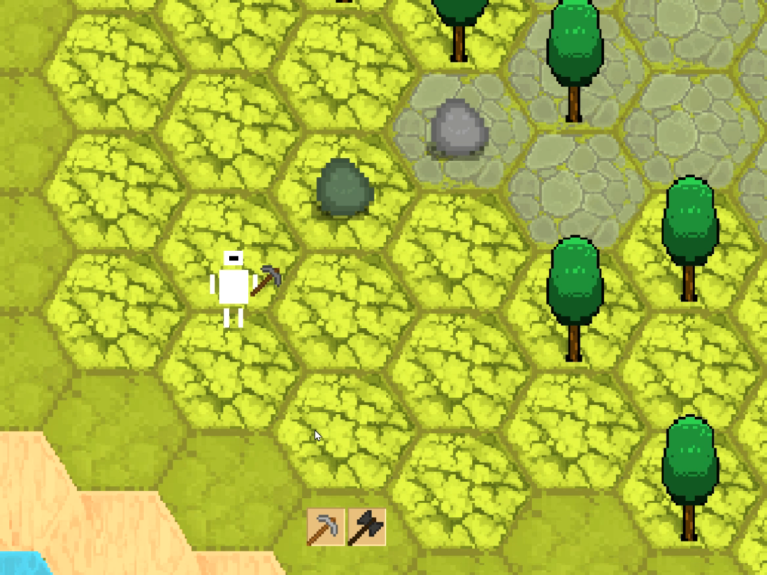
Structs
Different structs with different recipes
Struct leveling system
Buildable by the player

Slide 14
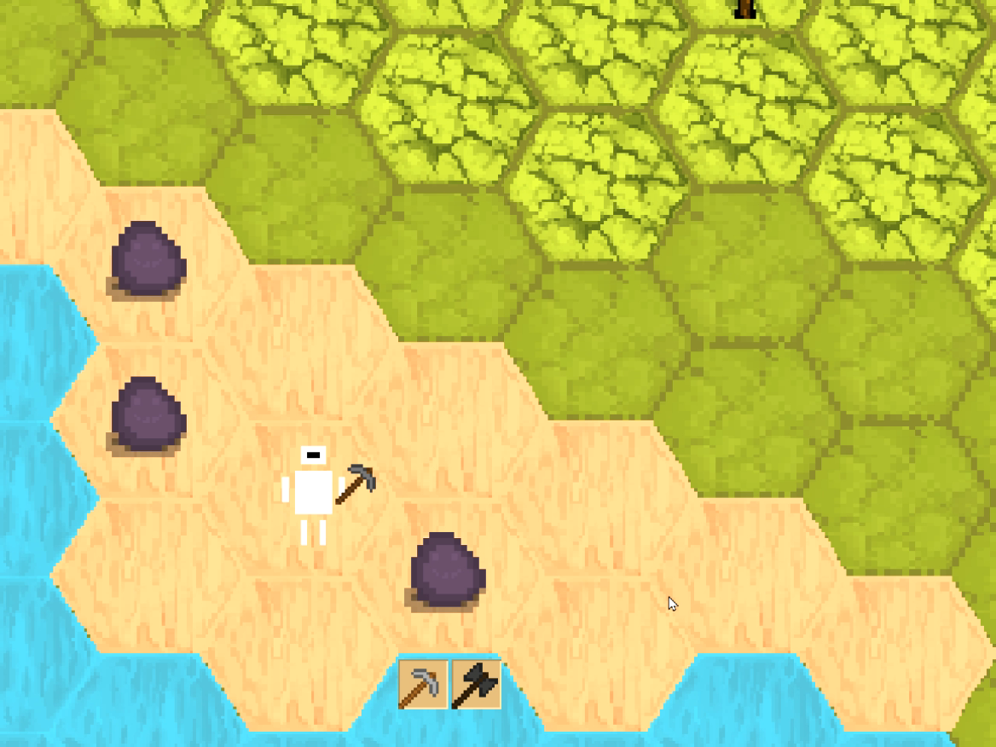
Zones
Varying spawns per region
Each region unique mat
Regions locked behind game progression
Looking forward

Slide 15
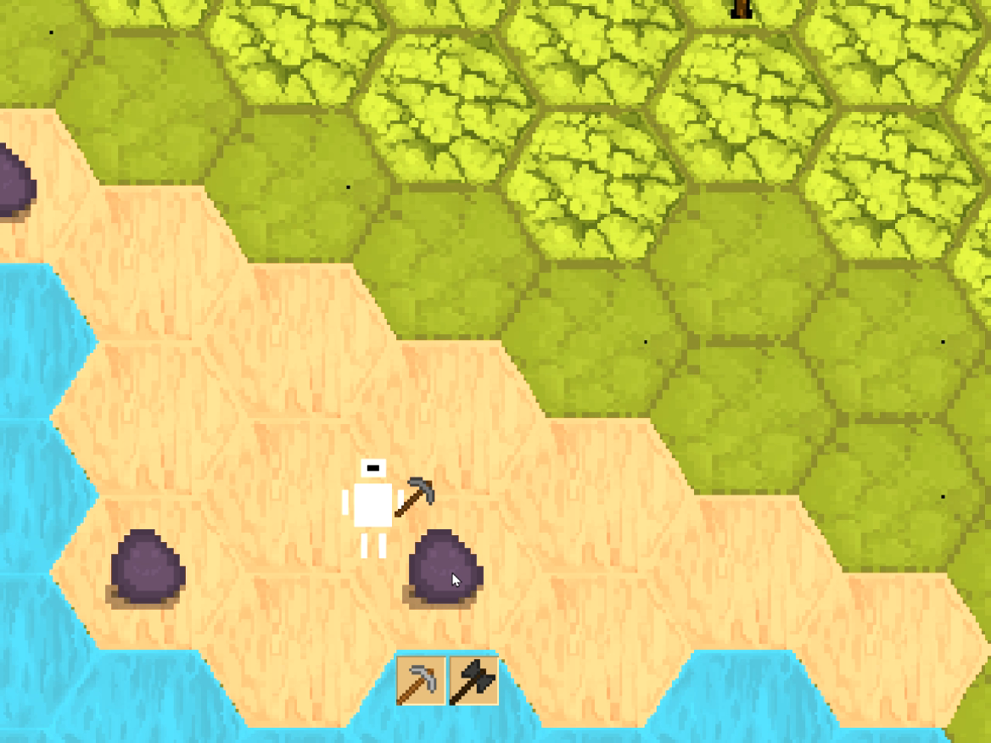
Nodes
Given health and varying drops
Controlled by Parent Object
Determined by a zone-specific spawner

